Slide 1
Islamic Finance in Historical Perspective
S. Nazim Ali
Harvard Law School

Slide 2
Pre-Modern Islamic Finance History
Since the time of Prophet Mohammad, Islamic partnerships and trade dominated business world for centuries.
Concept of interest found very little application in day-to-day transactions.
Mudarabah (trust investment) used in 11th century trade between Egypt and Tunisia.
Musharakah (joint venture) used in 11th century trade between Egypt and Syria and between Egypt and Jeddah.
European Middle Ages: “Commenda” and “maona” - two popular financial instruments in the Europe Middle Ages – originated in the Islamic world.
Commenda was identical to murabahah (cost-plus sale)
Maona partnerships were either mudarabah (trust investment) or musharakah (joint venture)
This info was transmitted via Jewish scholars to Europe.
Colonial Period
Most Muslim countries, under colonial power influence, adopted Western-style banking systems, deserting traditional shariah-compliant financial practices
Source: Iqbal, Z., & Mirakhor, A. (2006). An Introduction to Islamic Finance: Theory and Practice (Wiley Finance). New York, NY: Wiley
Notes:
-”Very little”: It depends on the era. If this refers to the Muslim community, “very little” should be changed to “no”.
-Just thought it will more appropriate to translate mudarabah as (trust investment).
-

Slide 3
Early Islamic Financial History
1940’s Theoretical discussions
1950’s Beginning of non-bank applications or interest-free finance
1960’s Tabung Hajj, a saving scheme for Hajj hopefuls in Malaysia and continues to this day
1963-67 Mit. Ghamr Bank formed to mobilize savings
1971: Nassir Social Bank established by Central Bank of Egypt to integrate Islamic institutions into formal banking system.

Slide 4
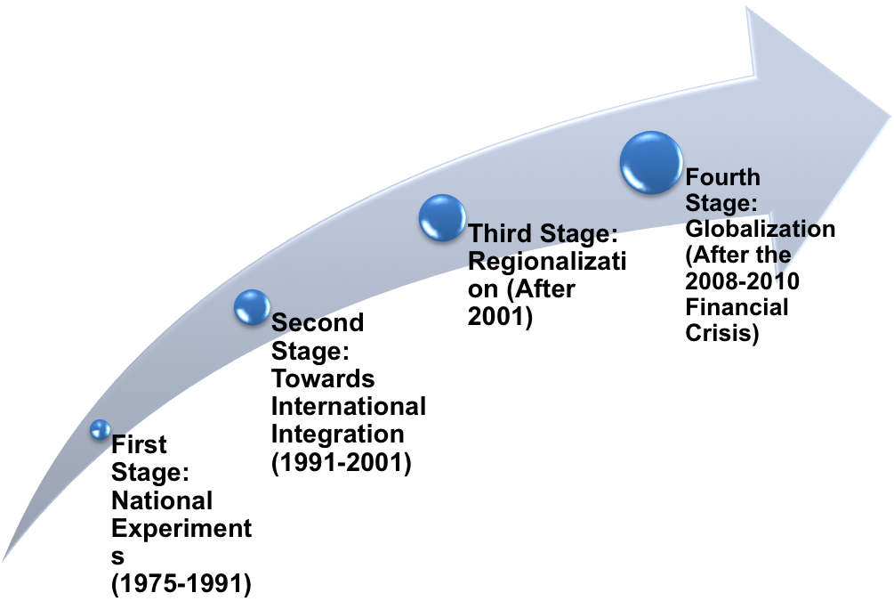
Current Practice of Islamic Finance
Three Stages of Islamic Finance
Notes:
In my recent classification of the stages of development of Islamic finance, I argued that there are 4 stages. While I agree with the first three stages, a fourth stage began after the recent financial crisis of 2008-2010 which ushered in a new stage that can be referred to as “Globalization”. So, the third stage which began in 2001 ended at the end of 2007 when the global financial crisis began. During and after the crisis, there is a general shift of attention to Islamic finance industry by the West.

Slide 5
Economic and Political Context of Modern Islamic Finance
Pan Islamism
From Pan-Arabism to Pan-Islamism
1970: the creation of Organization of Islamic Cooperation (OIC), formerly “Organization of Islamic Conference”.
Notes:
“Organization of Islamic Conference” recently changed to “Organization of Islamic Cooperation”

Slide 6
Economic and Political Context of Modern Islamic Finance
The Petrodollar windfall
Oil Embargo; new oil supply-demand picture and the changing bargaining power of oil producing countries
The quadrupling of the price of oil (73-74)
Financial experimentation

Slide 7

First Stage: National Experiments
(1975-1991)
First Stage
Pan Islamism and start of new interest in Islamic economics and finance
A new Ijtihad: redefining financial concepts and practices to devise a system at once consistent with religious percepts and practical.
Third OIC meeting in Jeddah (1972)
King Faisal committed to the idea of an Islamic banking system

Slide 8
The Islamic Development Bank
First Stage
1974 OIC summit in Lahore: creation of IDB
44 countries were founding members; largest shareholders Saudi Arabia (25%), Libya (16%), UAE (14%), and Kuwait (13%).
Subscribed capital: 2 billion Islamic dinars (2 billion special drawing rights)
IDB Goals
Became operational in 1975
Later creation of the IRTI, a unit dedicated to research and training in IF &E

Slide 9
The First Islamic Banks
First Stage
Main players: Gulf States (especially Saudi Arabia) for capital, Egypt, Pakistan for manpower
Dubai Islamic Bank: first commercial institution created in 1975
KFH (1977)
Faisal Islamic Bank of Egypt (1977) and Faisal Islamic Bank of Sudan (1977)
Jordan Islamic Banking and Finance Investment (1978)
Bahrain Islamic Bank (1978)

Slide 10
Beyond Commercial Banks
First Stage
Islamic Investment Company of the Gulf (Nassau, 1977; Sharjah 1978)
Sharia Investment Company Geneva (1980)
Bahrain Islamic Investment Bank (1980)

Slide 11
Main Characteristics
First Stage
Typically, one or two Islamic banks in those countries where Islamic banks were allowed
Ambiguous regulatory environment (often outside Central bank regulation)
International regulatory environment: pre-deregulation

Slide 12
Early Developments
First Stage
Full Islamization of banking:
Pakistan (1979), the Sudan (1982), and Iran (1983)
Attempts at common standards and practices: the International Association of Islamic Banks (since 1977)

Slide 13
First Transnational Groups
First Stage
The DMI or Faisal Group: Dar al-Maal al-Islami founded in 1981, headquartered in Geneva
The Al-Baraka Group: Dallah Al-Baraka Group founded in 1982 by Shaykh Saleh A. Kamel
Other groups: al-Rajhi, Kuwait Finance House

Slide 14

Transition to Second Stage
Transition to Second Stage
From Ideal to Reality
Trial and Error and Growing pains (teething problems)
New Ijtihad
Problems of fragmentation and lack of harmonization

Slide 15

Questioning the Future of Islamic Banks
Transition to Second Stage
The decline of oil prices after 1981
Losses in gold, foreign currencies and commodities
The Islamic money management companies episode in Egypt (84-88)
The collapse of BCCI (1991) and losses of FIBE

Slide 16

Changing Political-Economic Context
Transition to Second Stage
End of the cold war and the new role of financial markets
Financial globalization and technological change
Role of Islamic Middle classes
Towards Global regulation

Slide 17

The Second Stage (1991-2001)
Second Stage
Modernist interpretations
Impact of the downgrading of interest
New players
The Malaysian Model

Slide 18
Academic awareness
Second Stage
Faisal foundation: Islamic finance first chair was established - 1973
IDB Prize - 1980
Dallah established Center for Islamic Economics 1975
Harvard Islamic Investment Study - 1994

Slide 19
The Transformations of Islamic Finance
Second Stage
Creation of Islamic windows by conventional establishments
Islamic subsidiaries of western institutions
Product innovation and non-Muslims customers
Islamic Finance outside the Islamic world

Slide 20
Status of Islamic Banks
Second Stage
Slowly integrating within the global economy
Still a niche industry
Regulatory and Harmonization challenges

Slide 21
Country Differences
Second Stage
Diversity of historical experience and political, social and economic context, experience in IF, government commitments, etc)
Pressures for standardization, harmonization, international norms

Slide 22
September 11 and Islamic Finance
Second Stage
Attitudes toward Islam
New Awareness of Islamic finance
Policies and proclamations
The Treasury Departments
Scholar in Residence Program
Impacts of Accounts Freezings and the Financial War

Slide 23
Towards the Third Stage
Transition to Third Stage
End of Go-it-alone approaches
Islamic Revivalism
Capital outflows
Role of Malaysia, Bahrain and other countries

Slide 24
Other Factors
Transition to Third Stage
Sukuk and the new secondary markets
Evolution of oil prices
Politics and the war on terror

Slide 25
The Fourth Stage (2008 – Date)
A new stage after the global financial crisis
Islamic finance became globalized
Global interest in Islamic finance products in the West –sukuk
Insurance global giants such as AIG investing in Takaful
Islamic Interbank Benchmark Rate (2011)
Qatar’s decision to close Islamic windows of conventional banks
Notes:
In my recent classification of the stages of development of Islamic finance, I argued that there are 4 stages. While I agree with the first three stages, a fourth stage began after the recent financial crisis of 2008-2010 which ushered in a new stage that can be referred to as “Globalization”. So, the third stage which began in 2001 ended at the end of 2007 when the global financial crisis began. During and after the crisis, there is a general shift of attention to Islamic finance industry by the West.

Slide 26
The Role Harvard played in the development of the industry

Slide 27
Bringing Worlds Together
Islamic Finance Project at Harvard brings worlds together and has been a dynamic force in changing the industry.

Slide 28
Harvard’s contribution to Islamic finance and economics
Islamic Investment Study – 1994
Islamic Law and Finance: Religion, Risk, and Return
Islamic Finance Project & other programs

Slide 29
Harvard University Forum on
Islamic Finance
Think-tank – practitioners, religious scholars and academicians
Trends and developments
Relevant issues

Slide 30
Open discussions
Global Markets
Authenticity and Innovation
Regulation, Transparency, and Standardization
Challenges and Global Opportunities
Building Bridges across Financial Communities

Slide 31
Closed Debates
LSE- Harvard Workshops
Tawarruq
Sukuk
Risk Management
Ethics and Governance
Reformation of the Islamic Finance industry

Slide 32
Specialized Seminars and Panel Discussions
Dialogues with the US Regulators
Microfinance Conferences
The Global Impact of Islamic Finance
Public Lectures

Slide 33
Students and Faculty
Case Studies
Dissertations and Theses
Career Opportunities

Slide 34
Research & Development

